Slide 1

RUMYPET(R U my pet?)
Week 13
Team Groza
Kim Tae Hong (20132335)
Kim Chan Il (20150577)
(Presenter) Paeng Jin Wook (20154645)

Slide 2

Contents
Schedule & Progress
Problems & Solutions
Plans
Q&A

Slide 3
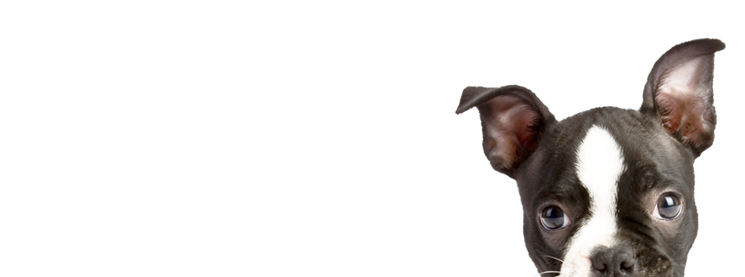
1. SCHEDULE & PROGRESS

Slide 4
SCHEDULE
Week |  | To-Do (can be changed)
Week 9 |  | Hold a meeting and make a Plan based on Midterm Demonstration.
Week 10 |  | Android : Image Upload Function. Server : Add a image data column in database and link with python code. Python : Link to the server
Week 11 |  | Android : E-mail Certification function. Server : link to python code completely and buy a server. Python : Find the way to save the feature template in database.
Week 12 |  | Android : Complete the detail function. (Edit Profile, etc...) Server : Divide the mode of the function in server. Python : Code refactoring and enhance the performance.
Week 13 |  | Android : Release the Beta Version and unit testing by users. Server : Complete developing the router of the Server. Python : Code refactoring and enhance the performance.
Week 14 |  | Final Demonstration
Week 15 |  | Report Submission
Week 16 |  | Survey & Final Arrangment
4
Notes:
This is the schedule later.

Slide 5
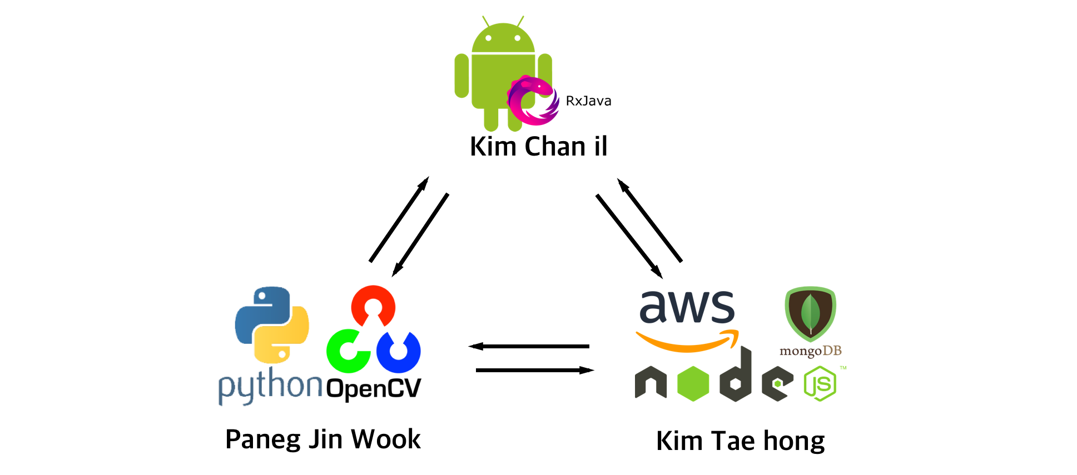
Role of this week
Week 13 |  | Android : Release a Beta Version and make Unit testing by users. Server : Complete developing the router of the Server. Python : Code refactoring and enhance the performance.
5

Slide 6




Schedule & Progress – Android & Server
“We complete most of the functions to release the Beta version in Android”
6
Notes:
This is the UI Deisign we did last week.
Using this, Chan il Kim applied this into Android Studio.

Slide 7

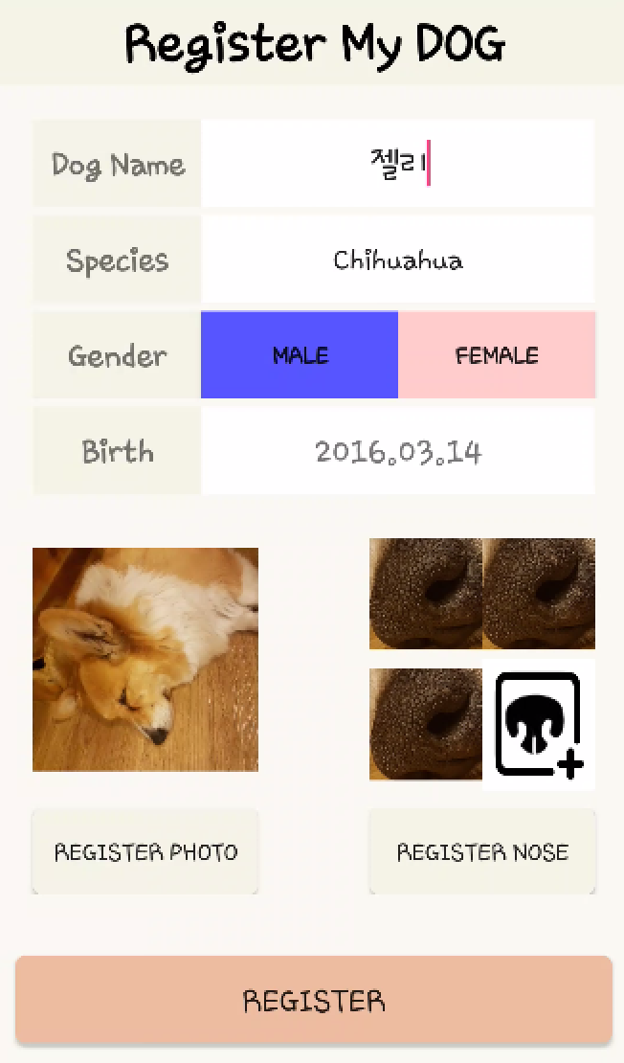


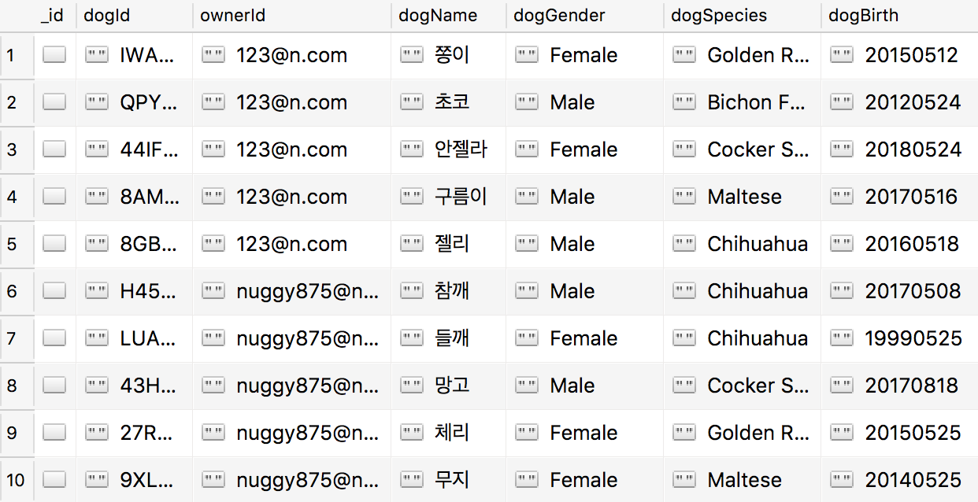
Schedule & Progress – Android & Server
“When user register the dog, the informations are saved in MongoDB”
7
Notes:
This is the UI Deisign we did last week.
Using this, Chan il Kim applied this into Android Studio.

Slide 8


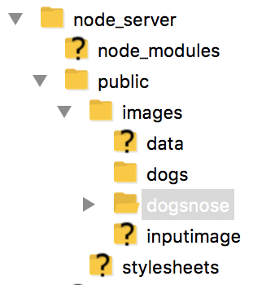
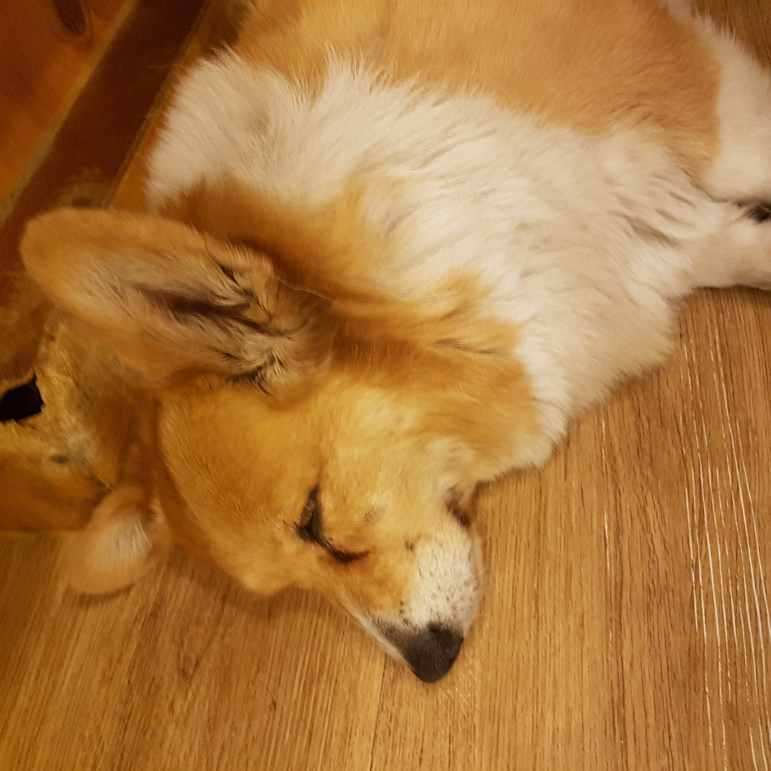
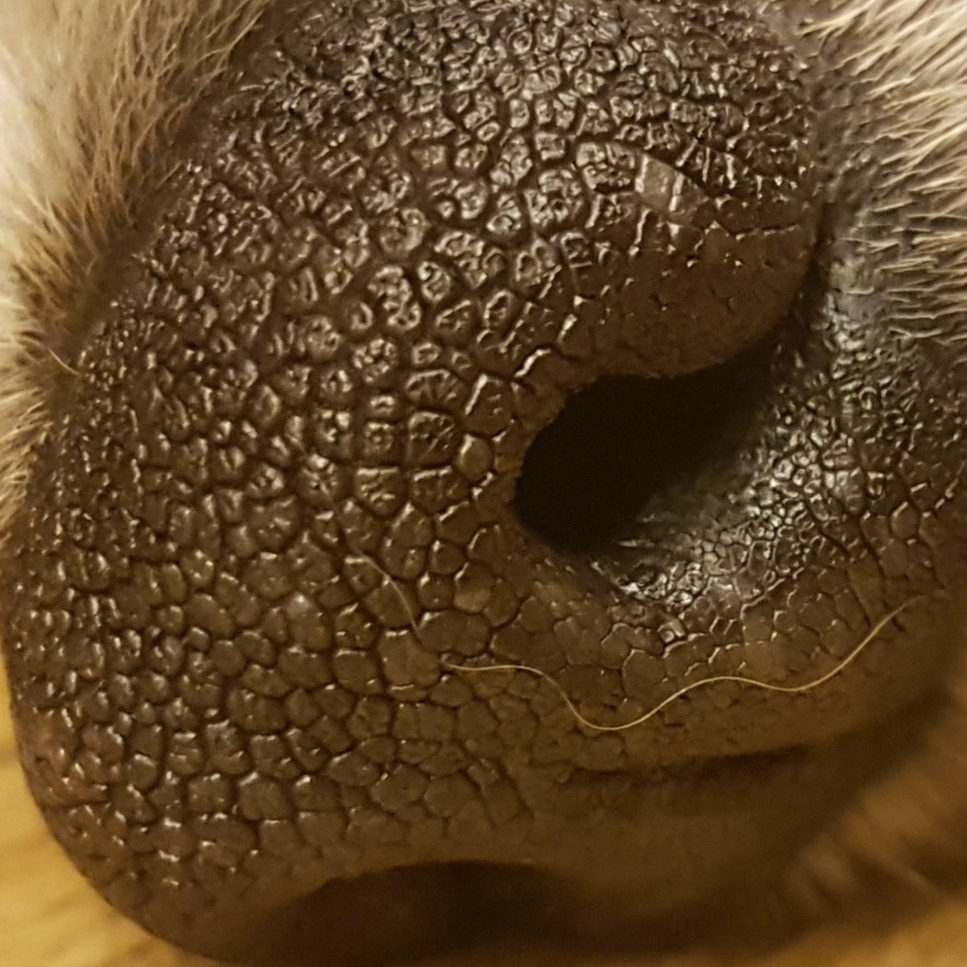
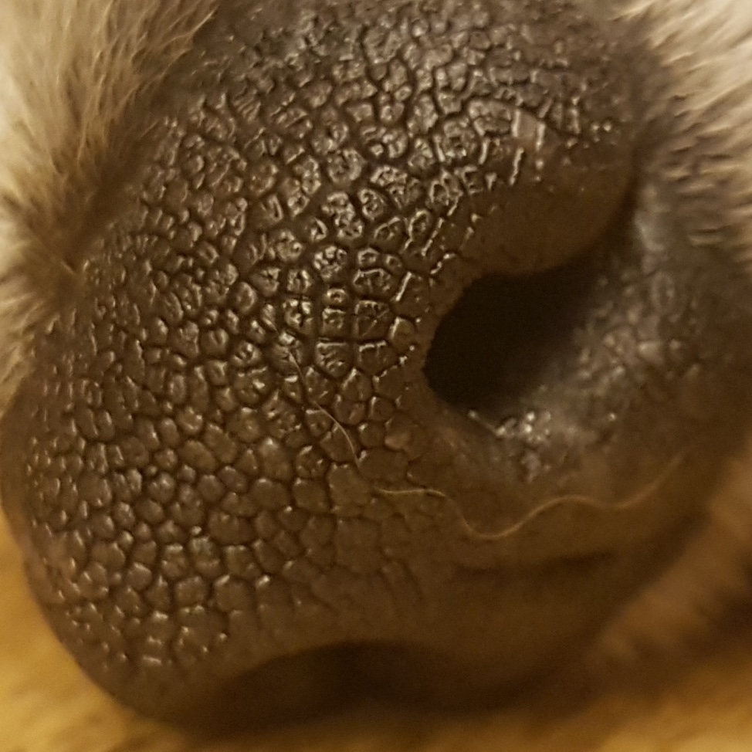
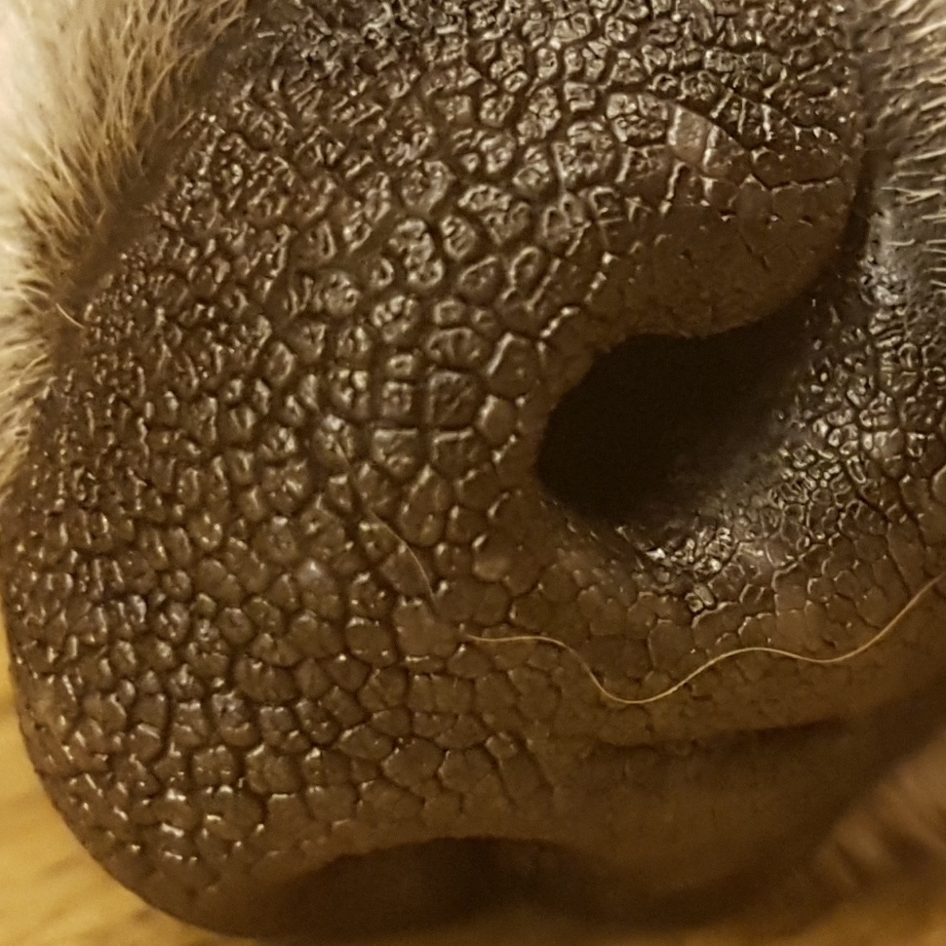
Schedule & Progress – Android & Server
“The images are saved in Local Storage of Server by Dog ID (random String)”
8
Notes:
This is the UI Deisign we did last week.
Using this, Chan il Kim applied this into Android Studio.

Slide 9

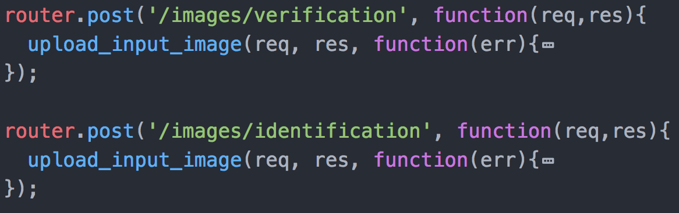
Schedule & Progress – Server
“Divide router for MODE 1(Verification) and MODE 2(Identification)”
9
Notes:
This is the UI Deisign we did last week.
Using this, Chan il Kim applied this into Android Studio.

Slide 10
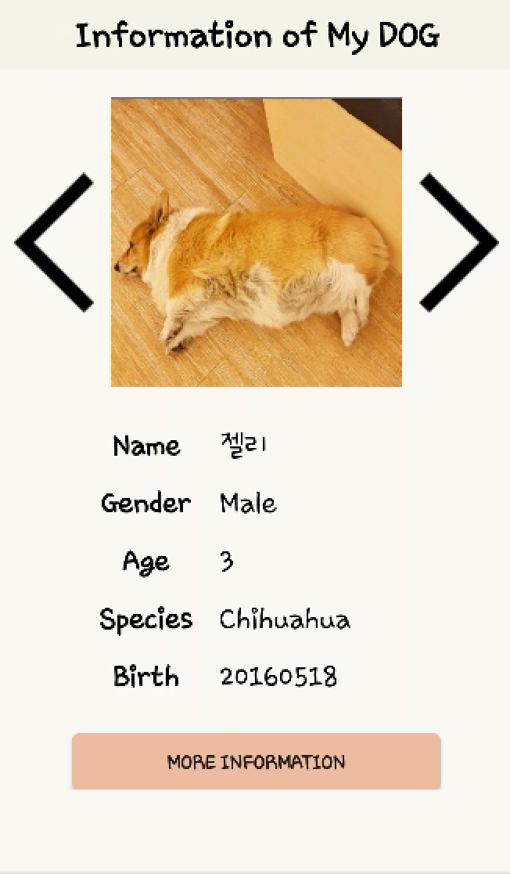

Schedule & Progress – Server (in mode 1)
“MODE 1 needs verification to get your dog’s private information”
Taking picture
“True” or ”False”
10
Notes:
This is the UI Deisign we did last week.
Using this, Chan il Kim applied this into Android Studio.

Slide 11
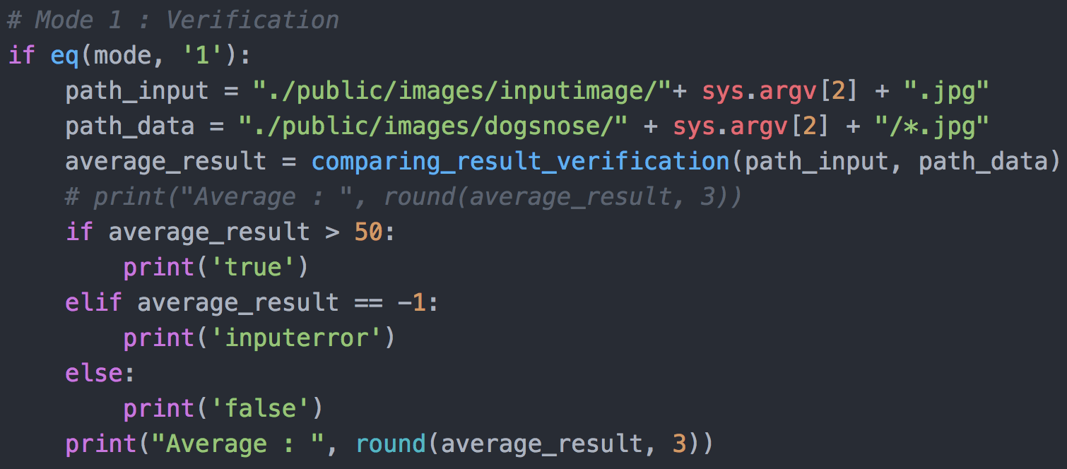
Schedule & Progress – Python (in mode 1)
“In Python for MODE 1, if the average of the result is over than 50,
it returns ‘True’, and if below, it returns ‘False’ ”
Input Image
“50 is based on many performance test”
11
Database
Notes:
This is the UI Deisign we did last week.
Using this, Chan il Kim applied this into Android Studio.

Slide 12
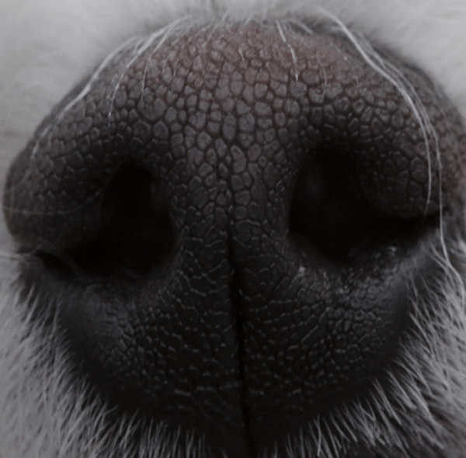
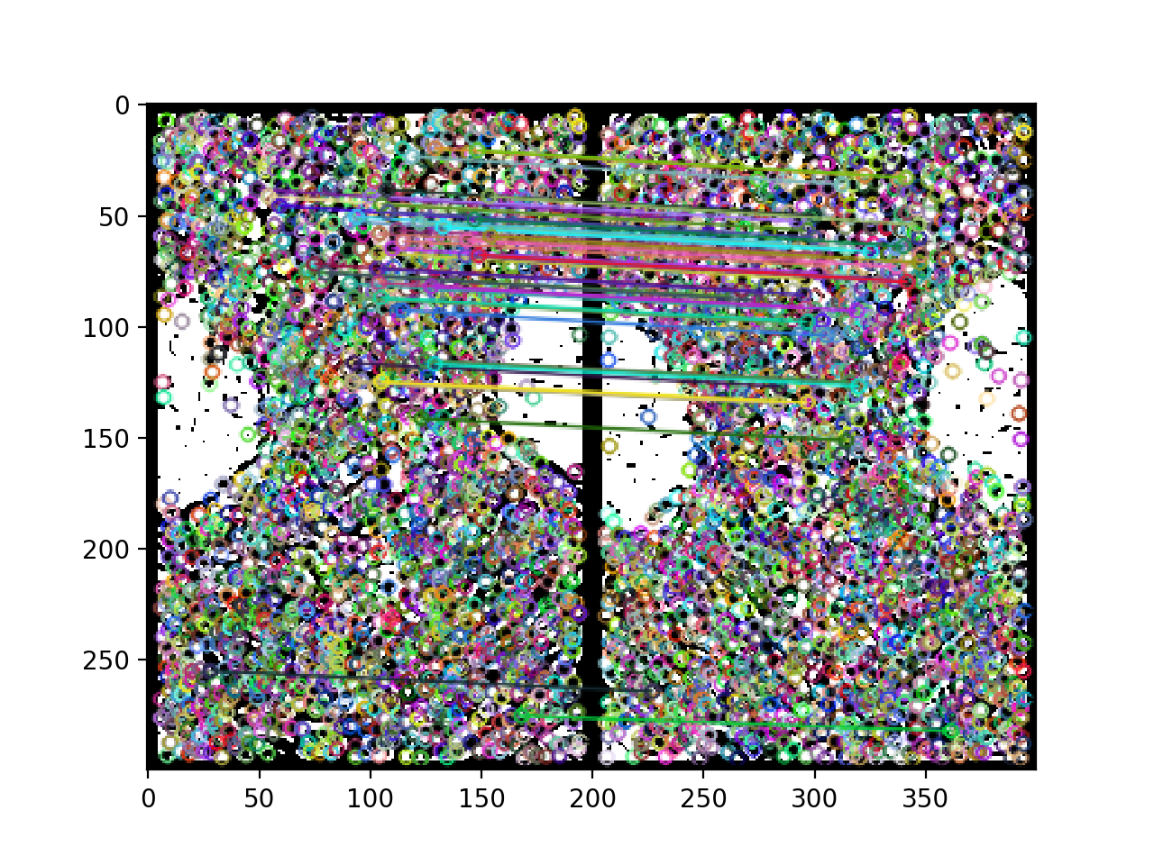
Schedule & Progress – Python (in mode 1)
“We used the Preprocessing method that we have developed.
But We didn’t have a progress in improving Feature matching Method (SIFT) ”
Pre-processing Method
Feature Matching Method
12
(SIFT)
Notes:
This is the UI Deisign we did last week.
Using this, Chan il Kim applied this into Android Studio.

Slide 13
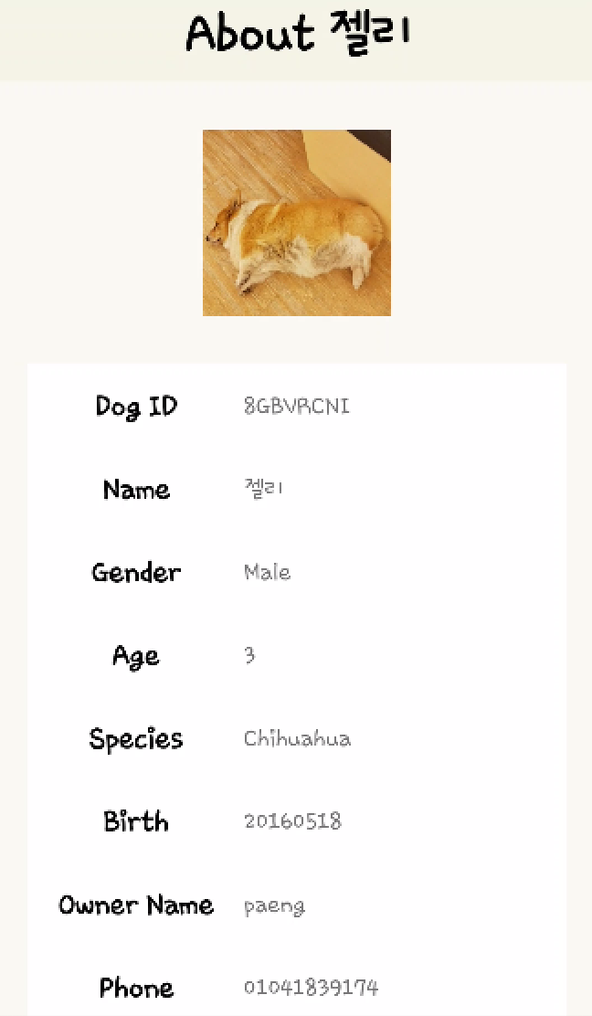
Schedule & Progress – Android (in mode 1)
“If TRUE, it will show you the dog’s private information in detail”
“True”
13
Notes:
This is the UI Deisign we did last week.
Using this, Chan il Kim applied this into Android Studio.

Slide 14
Schedule & Progress – Android (in mode 1)
“If FALSE, it will show you Nothing”
“False”
“Verification Failed”
14
Notes:
This is the UI Deisign we did last week.
Using this, Chan il Kim applied this into Android Studio.

Slide 15
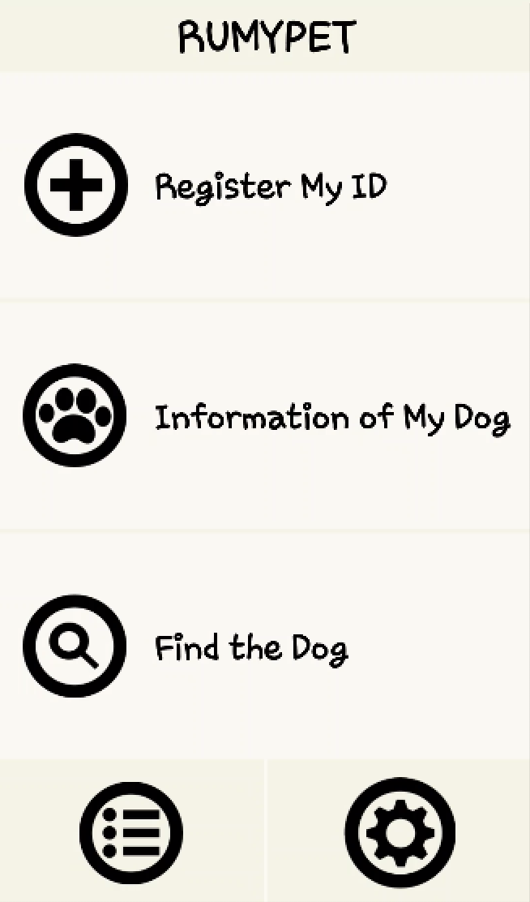
Schedule & Progress – Android (in mode 2)
“In our simple main page, you can get into the find the dog mode”
15
Notes:
This is the UI Deisign we did last week.
Using this, Chan il Kim applied this into Android Studio.

Slide 16
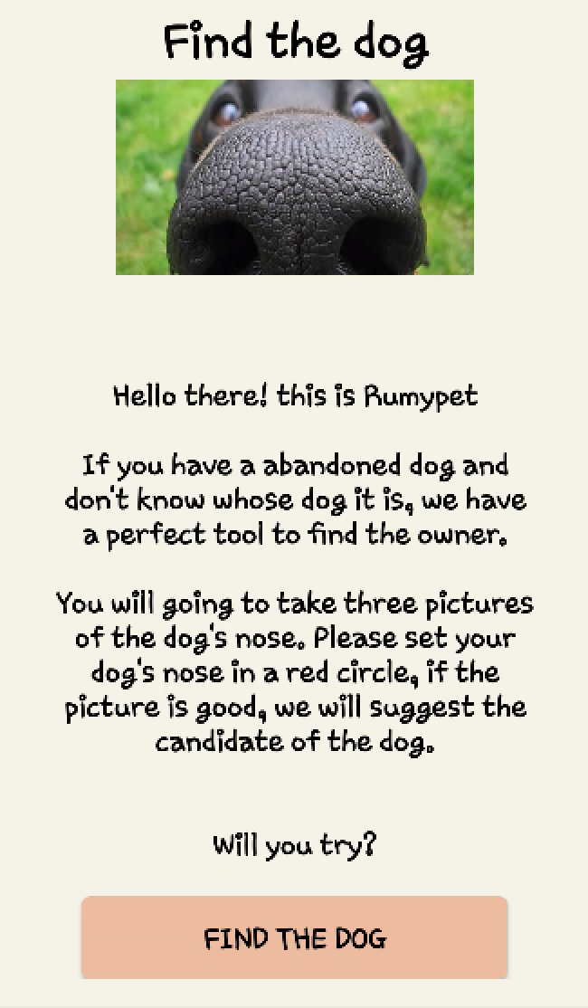
Schedule & Progress – Server (in mode 2)
“For MODE 2, we made a router of /identification”
Taking 3 pictures
”It is dog C”
16
Notes:
This is the UI Deisign we did last week.
Using this, Chan il Kim applied this into Android Studio.

Slide 17
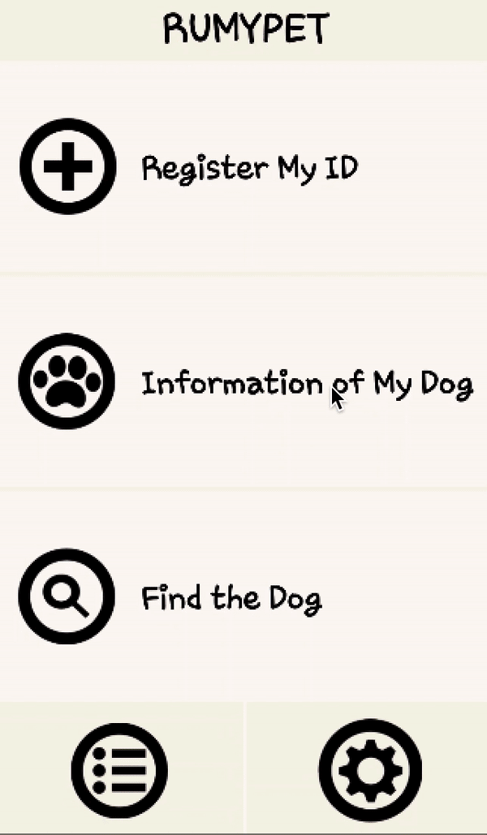
Schedule & Progress – Server (in mode 2)
“Let me show you the performing process”
17
Notes:
This is the UI Deisign we did last week.
Using this, Chan il Kim applied this into Android Studio.

Slide 18
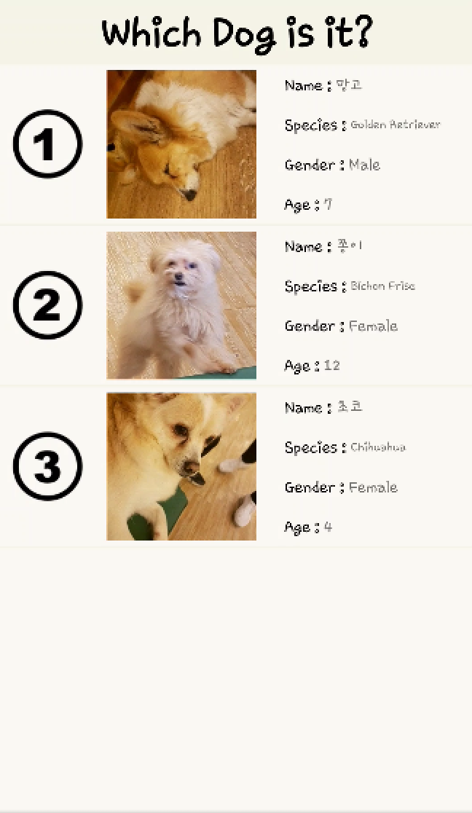
Schedule & Progress – Android (in mode 2)
“We made a candidate through the result score of the matching algorithm”
“You can click one of the list view to check the owner’s information”
18

Slide 19
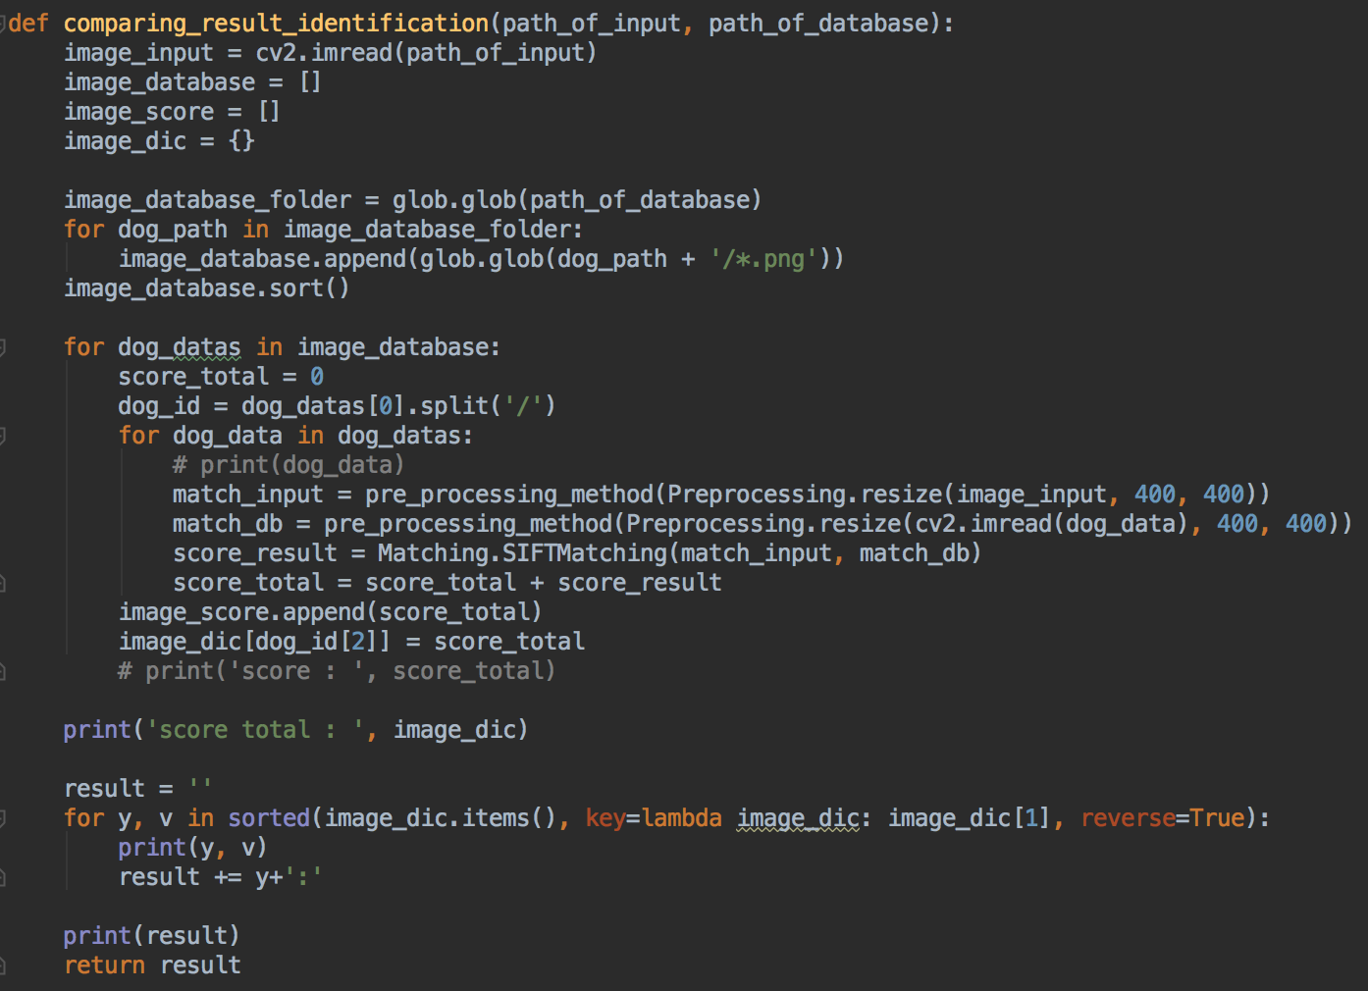
Schedule & Progress – Python (in mode 2)
“In Python for MODE 2, the function returns string data in order of the matching score”
Input Image
19
Database
Notes:
This is the UI Deisign we did last week.
Using this, Chan il Kim applied this into Android Studio.

Slide 20
2. PROBLEMS & SOLUTION

Slide 21

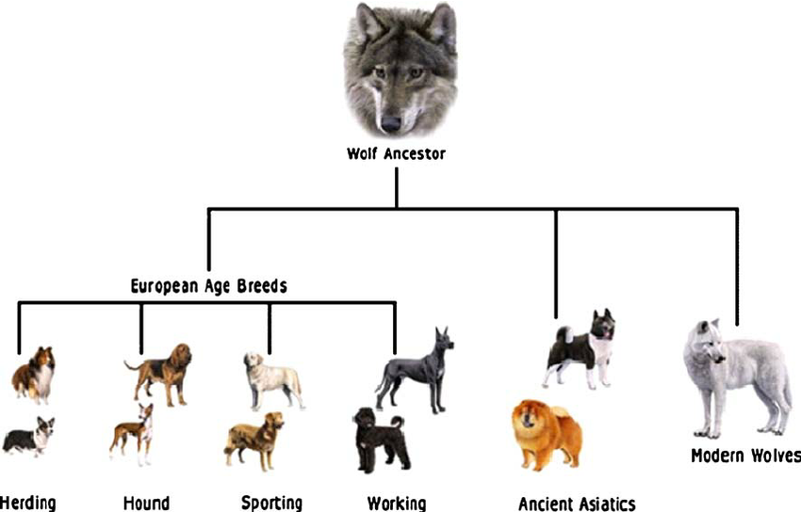
PROBLEMS & SOLUTIONS
Problem 1
Still, the process time is the problem... We don’t have that much data of the dog now in the database, but when it becomes commercialized, It should have some solutions.
Solution 1
Classification of the dog datas can help in some extent.
After, we should classify the dog datas
by species, colors or something else.
It could save much more time.
21
Notes:
--ppt reading--
Now, we have our own server!

Slide 22

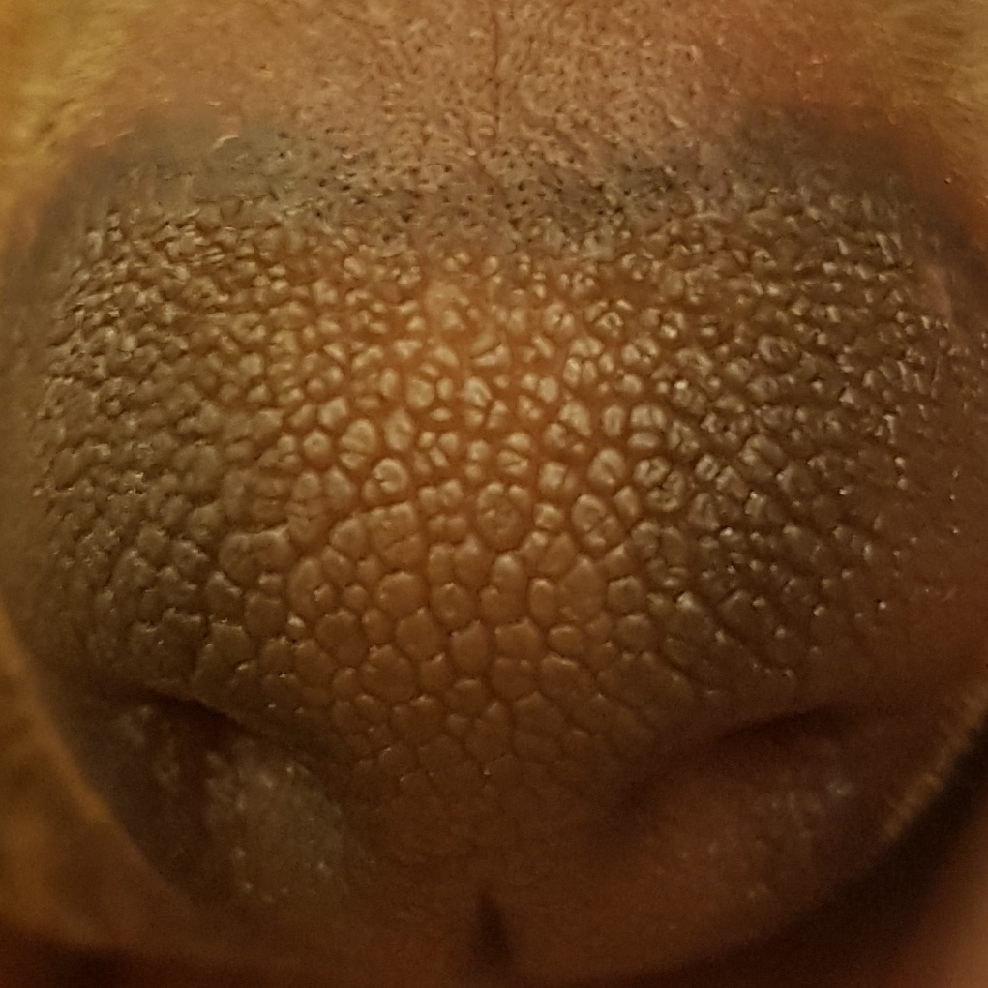
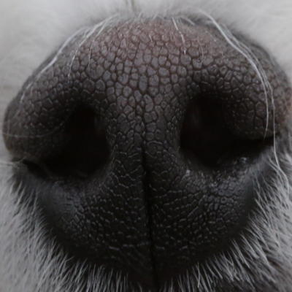

PROBLEMS & SOLUTIONS
Problem 2
We need more and more database for accuracy in testing
for pre-processing and feature matching algorithm.
But we have difficulty in collecting data...
Because the data should be a high resolution image.
It is rare...
Solution 2
To commercialize this project, we maybe should take some supports from the enterprise..
22
Notes:
--ppt reading--
Now, we have our own server!

Slide 23

3. PLANS

Slide 24
PLANS for next week
Week 14 | Final Demonstration
Notes:
ppt reading

Slide 25


Q&A

Slide 26
Thank you!

